Slide 1



Capstone Project on
Monkey Pox
Outbreak
by Dhairya Yadav

Slide 2


Table of Content
Introduction 3
Insights 8
Project Overview 4
Dashboard 14
Problem Statements 5
Conclusion 15
Methodology 7

Slide 3
Introduction
Mpox, previously known as monkeypox, is a viral illness caused by the monkeypox virus, a species of the genus Orthopoxvirus.
Mpox can be transmitted through close contact with someone who has mpox, with contaminated materials, or with infected animals. During pregnancy, the virus may be passed to the fetus, or to the newborn during or after birth.
Common symptoms of mpox are a skin rash or mucosal lesions which can last 2–4 weeks accompanied by fever, headache, muscle aches, back pain, low energy and swollen lymph nodes.

Slide 4
Project Overview
This project leverages data from the "MPOX" dataset to develop interactive dashboards using Power BI, providing insights into the spread and impact of mpox.
The dashboards will display key epidemiological metrics, such as total cases, deaths, and trends over time, to support public health decision-making.

Slide 5
Problem Statement
Geographical Distribution Analysis:
How does the distribution of mpox cases vary across different
locations.
Temporal Trends in Mpox Outbreak:
What are the trends in mpox cases and deaths over time.
Demographic Impact of Mpox:
How do demographic factors such as age and sex influence the incidence and severity of mpox across various WHO regions, and what demographic groups are most at risk?

Slide 6
Problem Statement
Analysis of Mpox Transmission:
What are the key transmission modes of mpox.
Risk Factors and Vulnerability Analysis:
What are the primary risk factors for mpox infection.

Slide 7
Methodology
1
Data Collection: Gather relevant information from the "MPOX" dataset, ensuring that all important metrics such as cases, deaths, and demographic details are accurately captured.
3
Identifying Key Metrics: Determine which data points are most critical for understanding the outbreak, such as trends over time, regional hotspots, and demographic vulnerabilities.
2
Data Cleaning & Transformation: Prepare the data by cleaning and formatting it, resolving any inconsistencies, and organizing it for analysis in Tableau or Power BI.
4
Design Principles: Apply best practices in dashboard design, focusing on clarity, accessibility, and usability, ensuring that complex data is presented in an easily interpretable format.

Slide 8


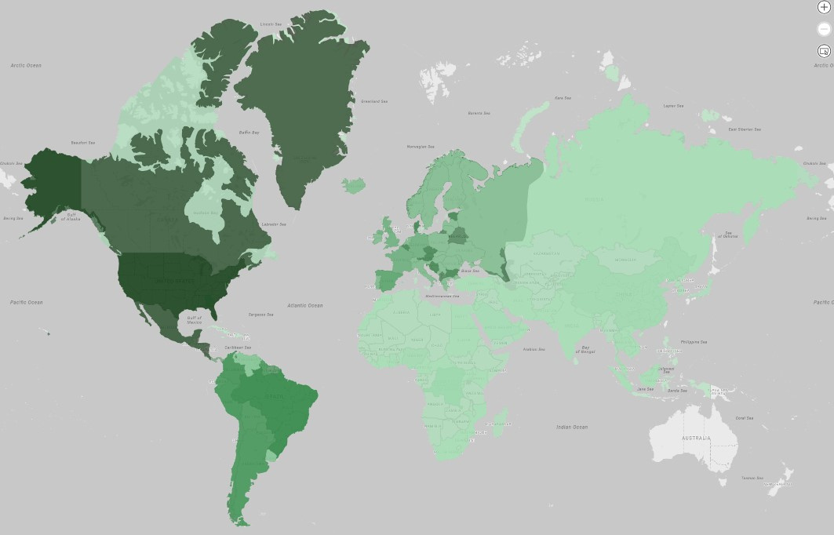
Insights
Geographical Distribution Analysis:
Regions with the darkest shading, such as North America and parts of Europe, report the highest number of mpox cases, highlighting significant outbreak hotspots.

Slide 9
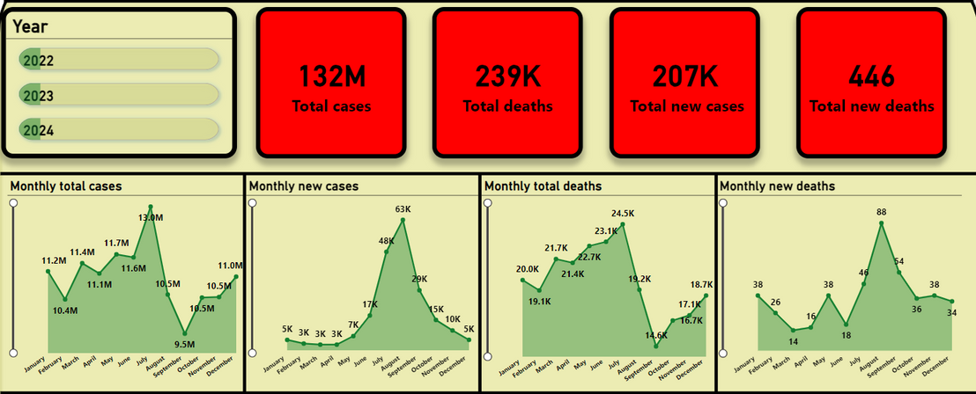
Insights
Temporal Trends in Mpox Outbreak:
The image shows key performance indicators (KPIs) with a total of 132M cases, 239K deaths, and 207K new cases across the years 2022, 2023, and 2024. The peak in monthly new cases occurred in July 2023 with 63K new cases and 24.5K total deaths, followed by a decline towards the end of the year.

Slide 10
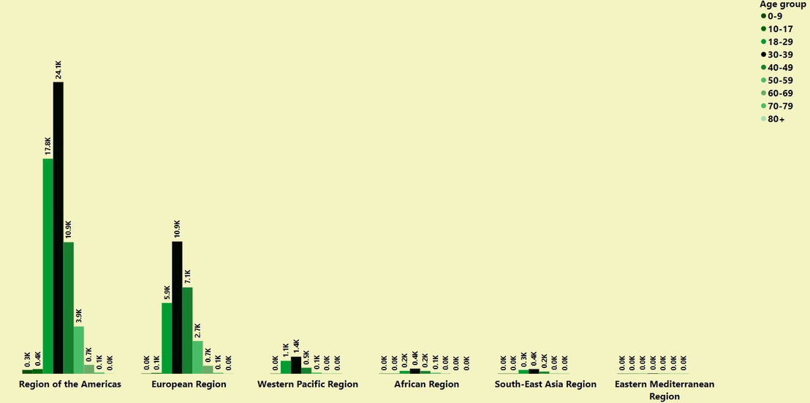
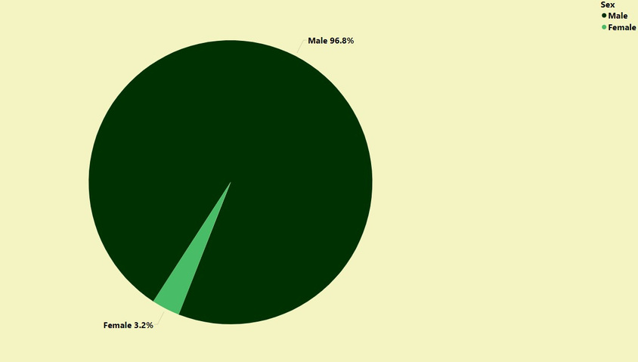
Insights
Demographic Impact of Mpox:
The age-specific distribution of monkeypox cases across WHO regions reveals that the Americas have the highest incidence, particularly among adults aged 30 to 49.
The vast majority of mpox cases, 96.8%, have been reported among males, with females accounting for only 3.2% of the total cases.

Slide 11
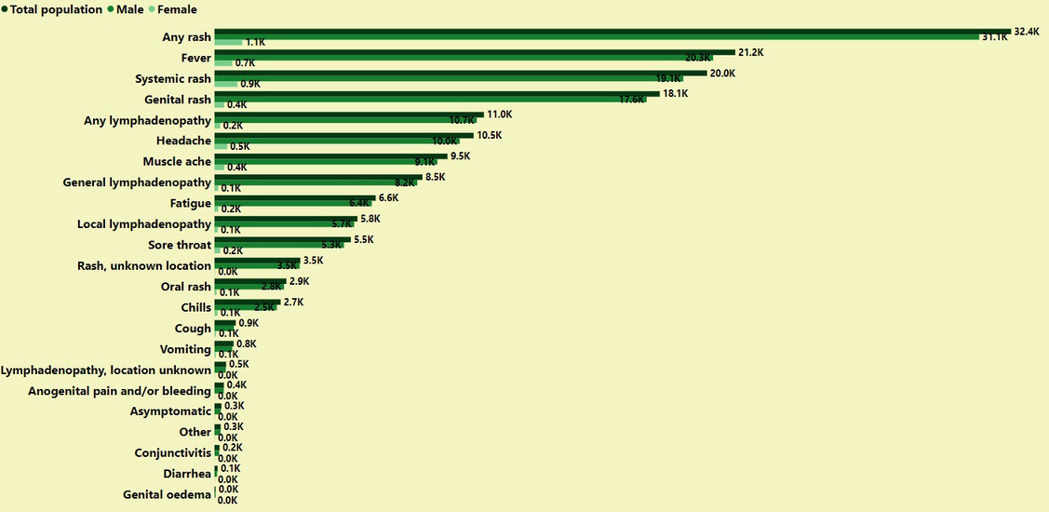
Insights
Analysis of Mpox Transmission:
The graph shows that the most common symptoms of monkeypox are fever, rash, and lymphadenopathy, with higher prevalence among males.

Slide 12
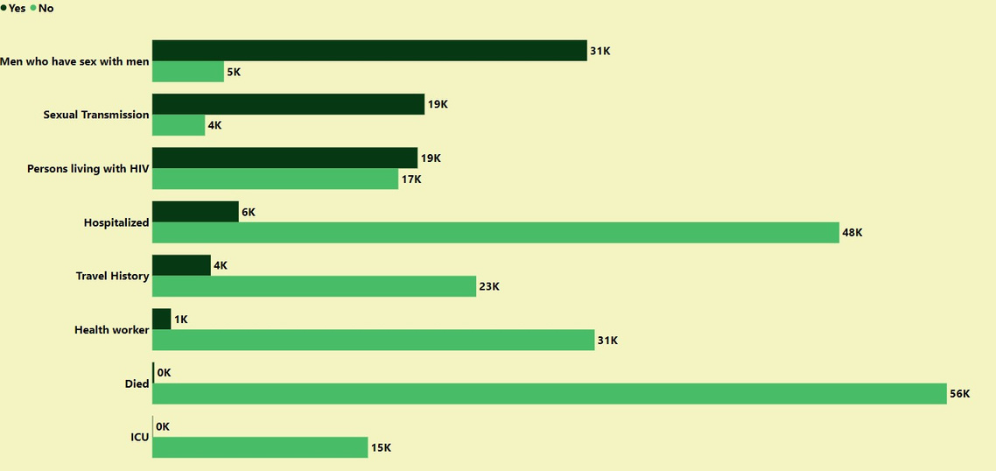
Insights
Risk Factors and Vulnerability Analysis:
The graph shows that the majority of monkeypox cases are among men who have sex with men, followed by those with a travel history and persons living with HIV.

Slide 13
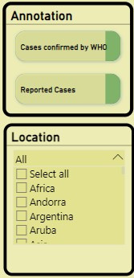
Insights
Filters:
Annotation and Location are two filters that are used in dashboard. The Annotation filter allows users to toggle between cases confirmed by the World Health Organization (WHO) and reported cases, providing flexibility in data analysis. The Location filter enables users to select all regions or individual countries, allowing for targeted exploration of data at different geographic levels.

Slide 14
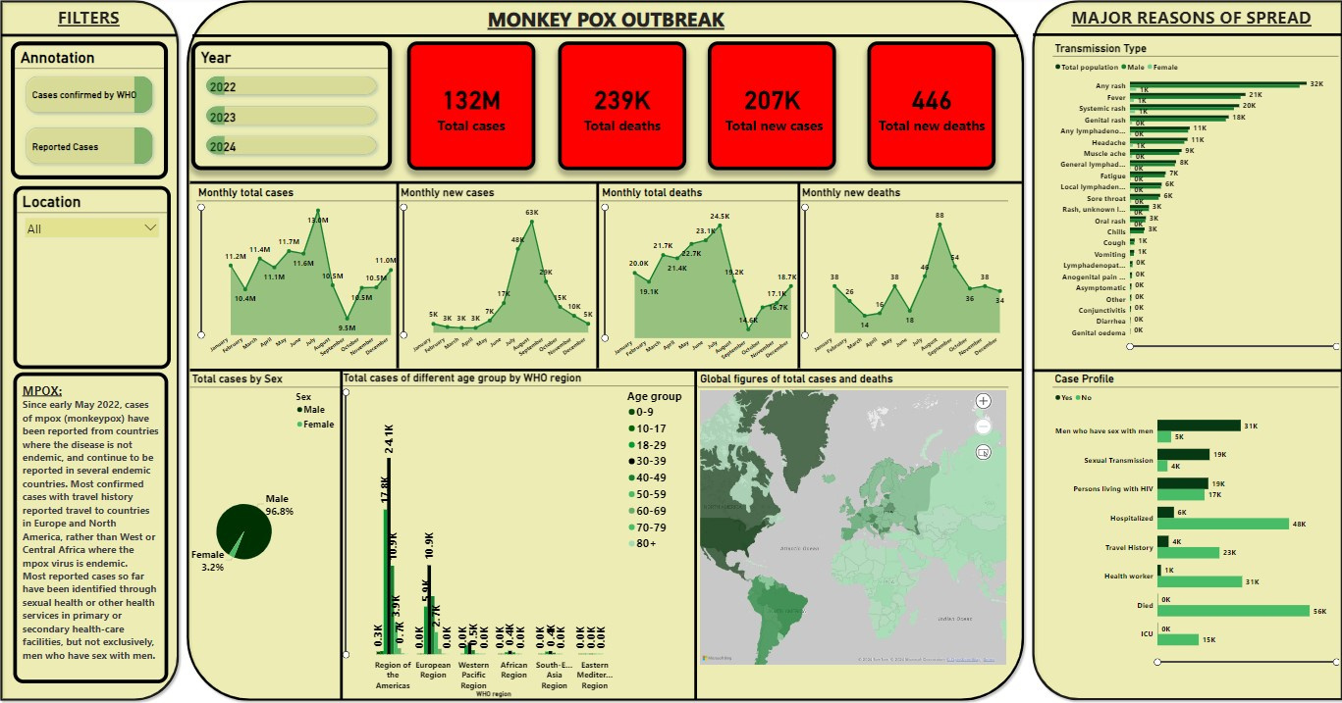
Dashboard

Slide 15
Conclusion
Global Impact: The outbreak has significantly impacted populations worldwide, with over 132 million reported cases and 239,000 deaths.
Age Distribution: The majority of cases are among individuals aged 30-39, followed by the 18-29 and 40-49 age groups.
Gender Disparity: Men account for the overwhelming majority of cases, with a significant gender gap.
Geographic Distribution: The Americas and the European Region have reported the highest number of cases, while the African Region has seen a relatively lower incidence.
Transmission Dynamics: Sexual transmission is the primary mode of spread, particularly among men who have sex with men.

Slide 16
Thank
You

